Slide 1
Module2
Image Enhancement in Spatial Domain and Frequency Domain

Slide 2

Image Enhancement
Objective of Image enhancement:
Process an image so that the result is more suitable than the original image for a specific application.
Category of Image Enhancement:
Spatial Domain Image Enhancement
The term spatial domain refers to the image plane itself.
Image plane contains the image itself and the approaches in this categories are based on direct manipulation of pixel in an image.
Frequency Domain Image Enhancement
The frequency domain in image processing represents, at each point a particular frequency contained
in the spatial domain of the image.
In frequency domain methods, the image is first transferred into frequency domain, it means that,
The Fourier Transform of the image is computed first. All the enhancement operations are performed
on the Fourier transform of the image and then the Inverse Fourier transform is performed to get the
resultant image.

Slide 3



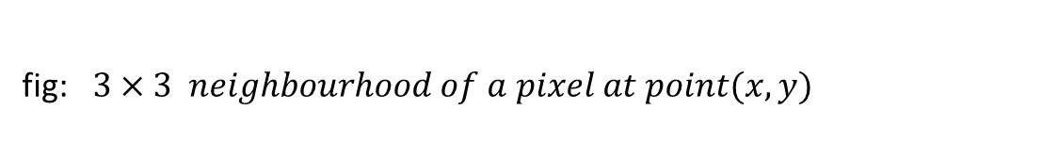
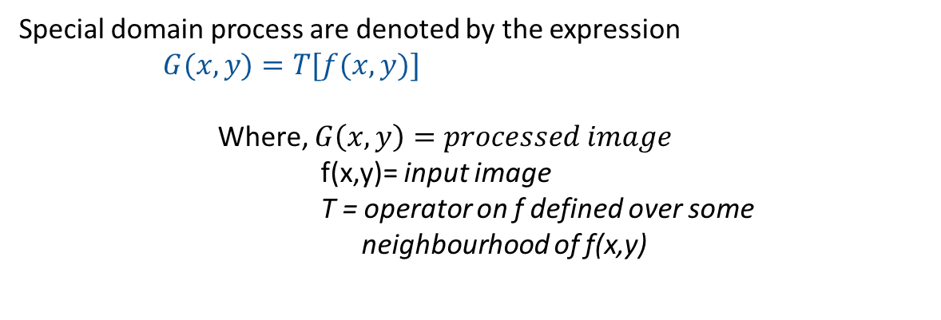
Spatial Domain Image Enhancement
y
(x,y)
Special domain process are denoted by the expression
$G(x,y)=T[f(x,y)]$
Where, $G\left(x,y\right)=processed image$
f(x,y)= input image
T = operator on f defined over some
neighbourhood of f(x,y)
3x3 neighborhood of (x,y)
Image f
x
fig: $3×3 neighbourhood of a pixel at point(x,y)$

Slide 4
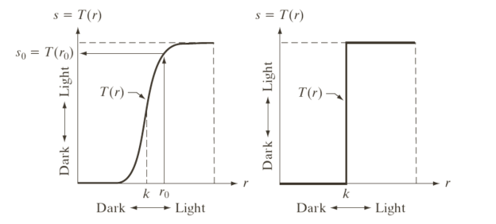
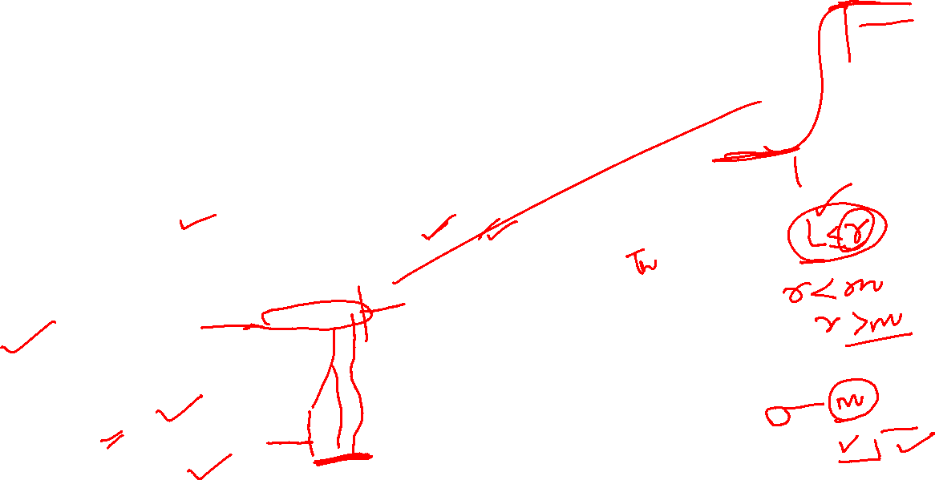
Grey Level Transformation Function
Point Processing
1x1 neighbourhood operation is called as point processing and is represented by the transformation function s= T(r) .
Where, s and r represents the intensity of g and f respectively.
Contrast stretching operation is performed by darkening the level below ‘m’ and brightening the levels above ‘m’ in the original image
Thresholding function produces a two level binary image. The value below r are transformed as black and above m are transferred as white.
Contrast stretching function
Thresholding function

Slide 5
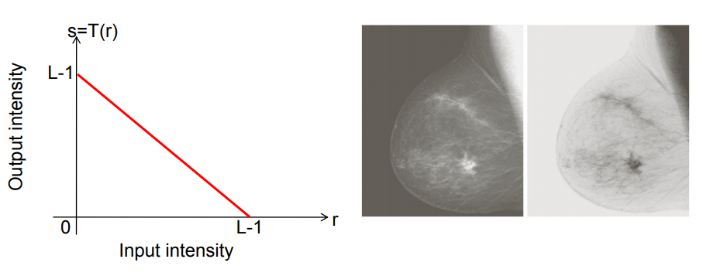
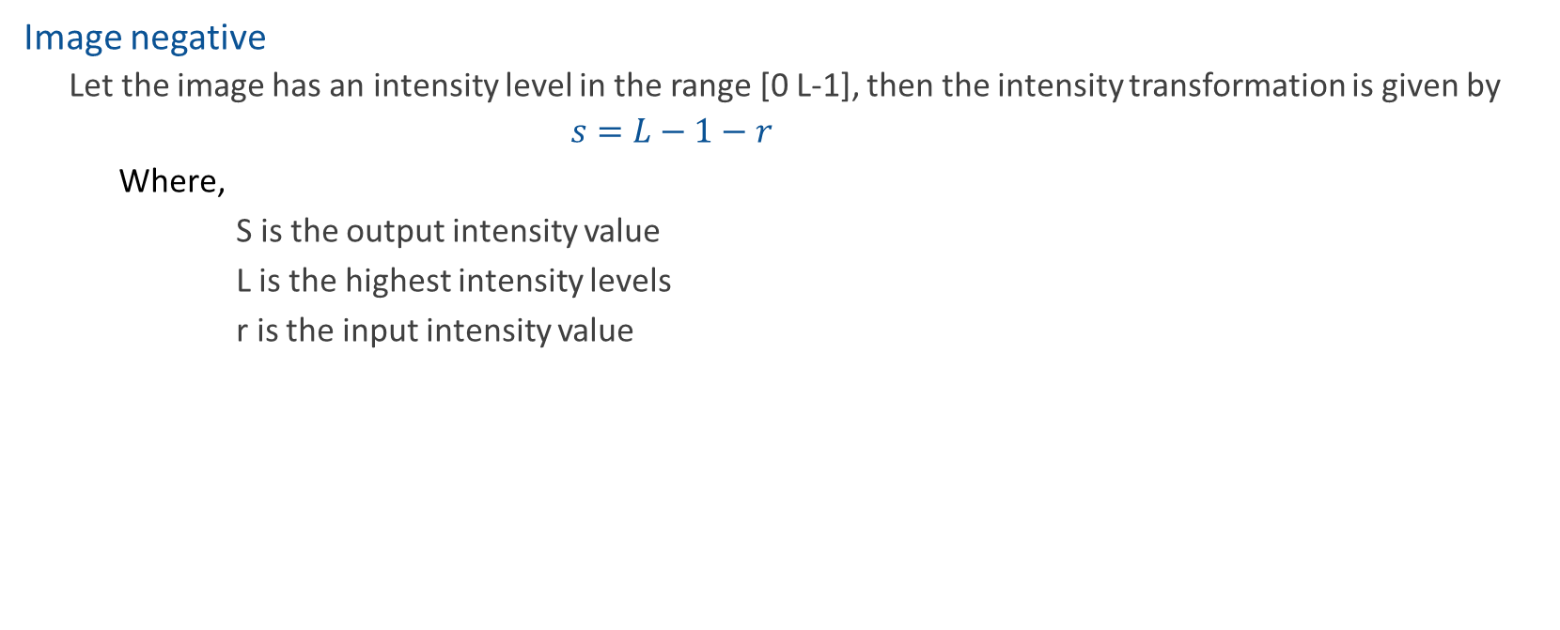
Grey Level Transformation Function
Image negative
Let the image has an intensity level in the range [0 L-1], then the intensity transformation is given by
$$s=L−1−r$$
Where,
S is the output intensity value
L is the highest intensity levels
r is the input intensity value
Particularly suited for enhancing white or grey detail embedded in dark regions of an image, especially when the black areas are dominant in size

Slide 6
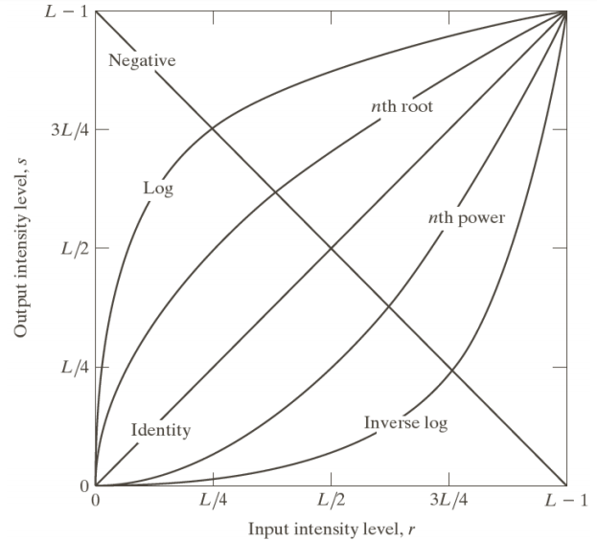
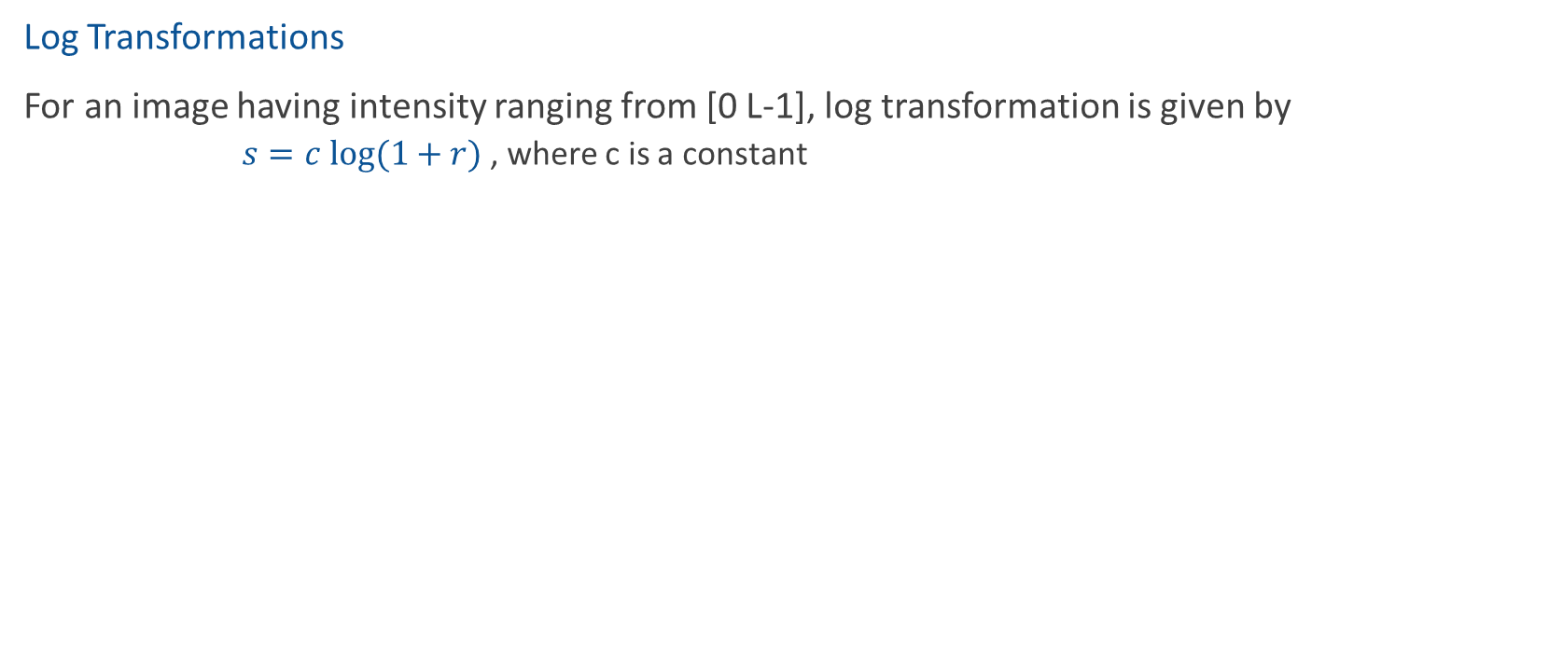
Grey Level Transformation Function
Log Transformations
For an image having intensity ranging from [0 L-1], log transformation is given by
$s=c log⁡(1+r)$, where c is a constant
log transformation compresses the dynamic range of images with large variations in pixel values.
It maps a narrow range of low intensity values in the input into a wide range of output levels.
The opposite is true of higher values of input levels.
It expands the values of dark pixels in an image while compressing the higher level values.

Slide 7
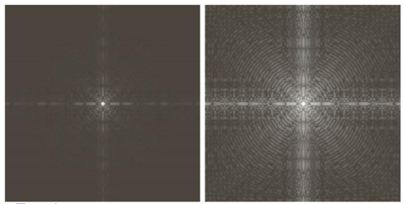

Grey Level Transformation Function
Log Transformations (cont’d)
Classical example of log transformation is displaying Fourier spectrum.
Fourier spectrum has the values in the range 0 to 1.5x106. These values are scaled linearly for the display in 8 bit system.
Fourier spectrum
Log transformation with c=1

Slide 8
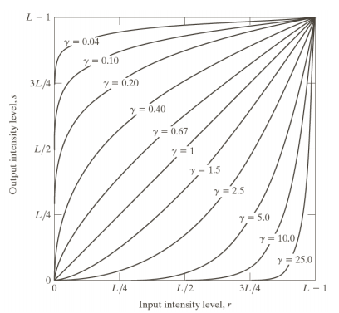
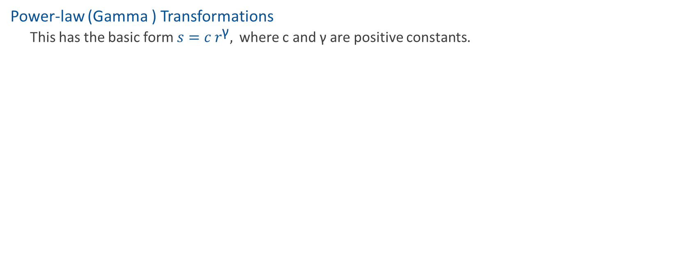
Grey Level Transformation Function
Power-law (Gamma ) Transformations
This has the basic form $s=c r^{\text{γ}},$where c and γ are positive constants.
Fractional values of γ maps a narrow range of dark input values into a wider range of output values. Opposite of this also true for higher values of input levels.
These are also called as gamma correction due to the exponent in the power law equation.
C=gamma=1 means it is an identity transformations.
Plot for c=1

Slide 9
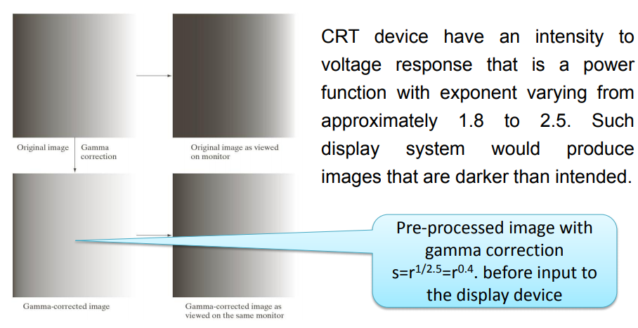

Grey Level Transformation Function
Power-law (Gamma )Transformations
Gamma correction is very important when to reproduce an image exactly on a display system.
Variety of devices used for image capture , printing, and display respond according to a power law.
Power-law transformations are also used in general purpose contrast manipulation.

Slide 10
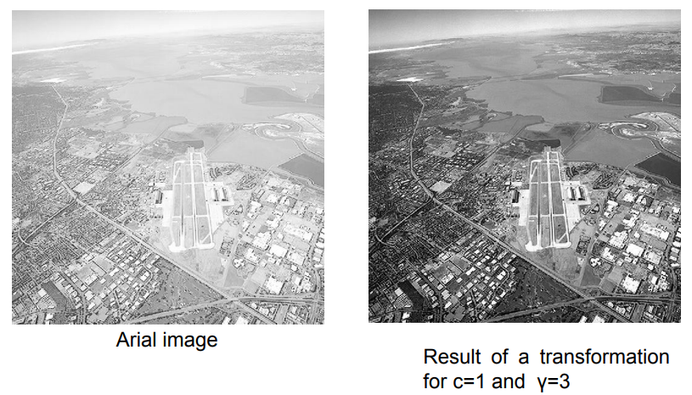
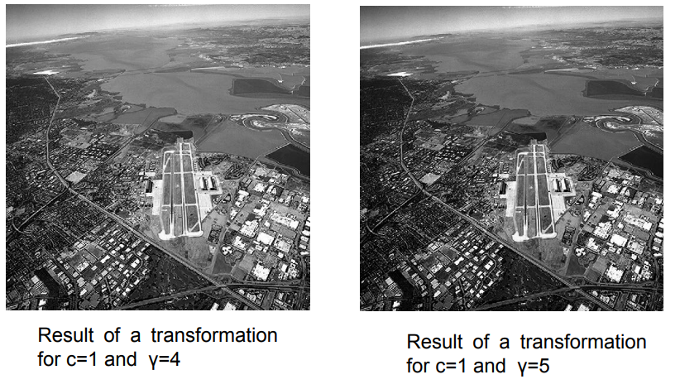

Grey Level Transformation Function
Example of some basic intensity transformation

Slide 11
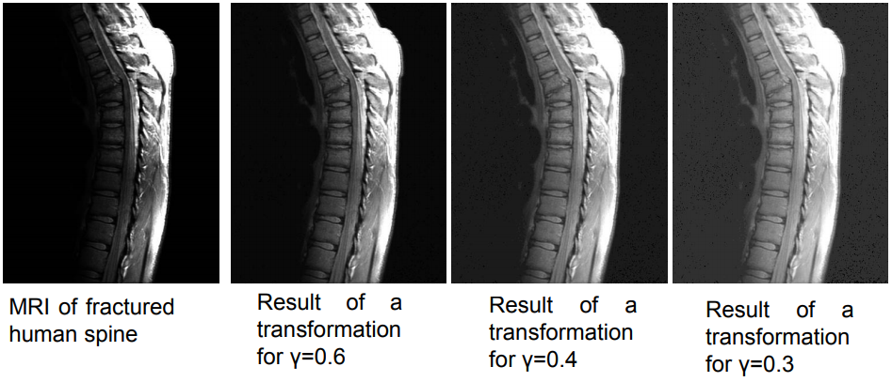
Grey Level Transformation Function
Example of some basic intensity transformation

Slide 12
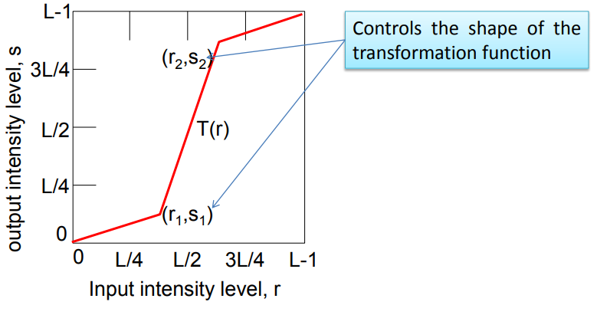
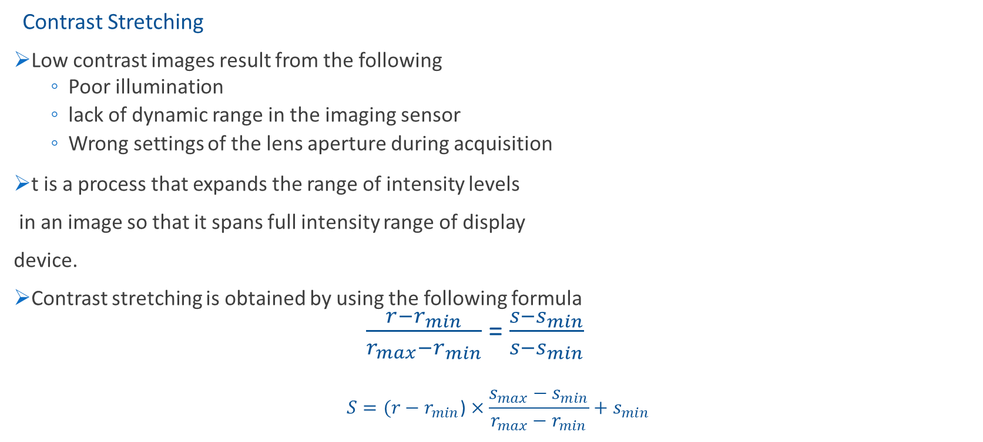
Piece Wise Linear Transformation Function
Contrast Stretching
Low contrast images result from the following
Poor illumination
lack of dynamic range in the imaging sensor
Wrong settings of the lens aperture during acquisition
t is a process that expands the range of intensity levels
in an image so that it spans full intensity range of display
device.
Contrast stretching is obtained by using the following formula
$\frac{r−r_{min}}{r_{max}−r_{min}}$ = $\frac{s−s_{min}}{s−s_{min}}$
$$S=(r−r_{min}\text{)}×\frac{s_{max}−s_{min}}{r_{max}−r_{min}}+s_{min}$$

Slide 13
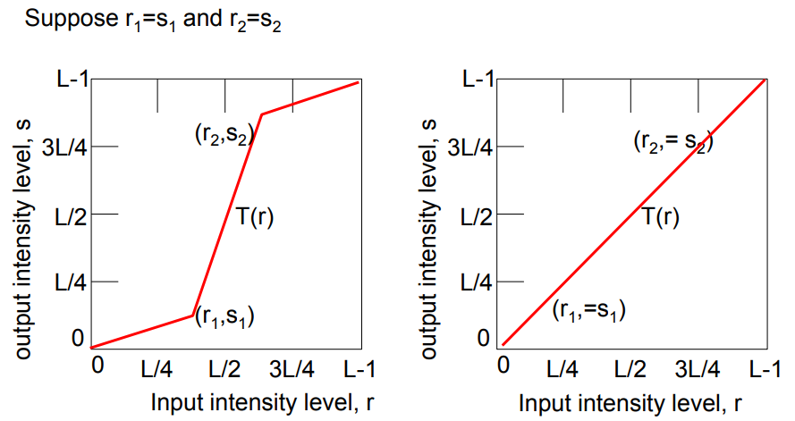
Piece Wise Linear Transformation Function
This transformation is linear function that deduces no change in grey levels.

Slide 14
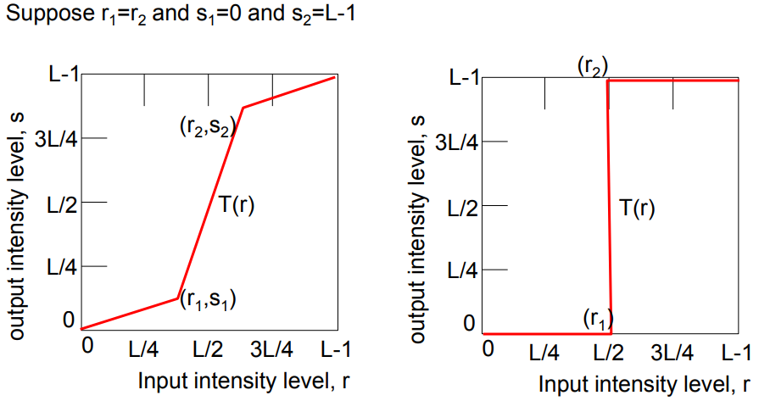
Piece Wise Linear Transformation Function
This transformation becomes a thresholding function that creates a binary image.

Slide 15
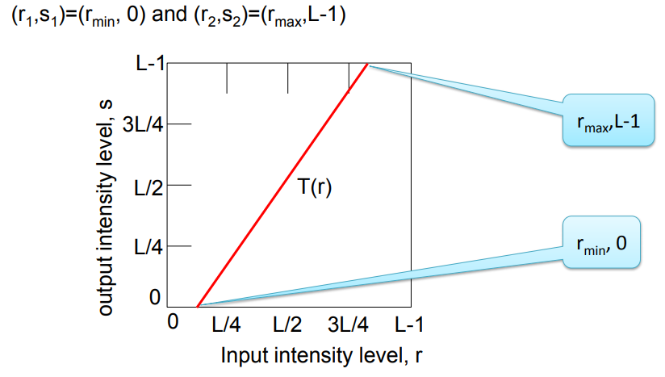
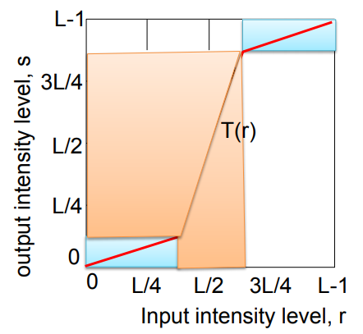
Piece Wise Linear Transformation Function
Intermediate values of (r1 ,s1 ) and (r2 ,s2 ) produces various degree of spread in the intensity.

Slide 16
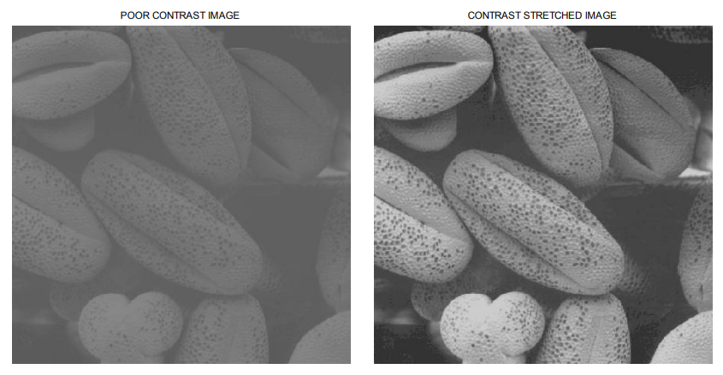
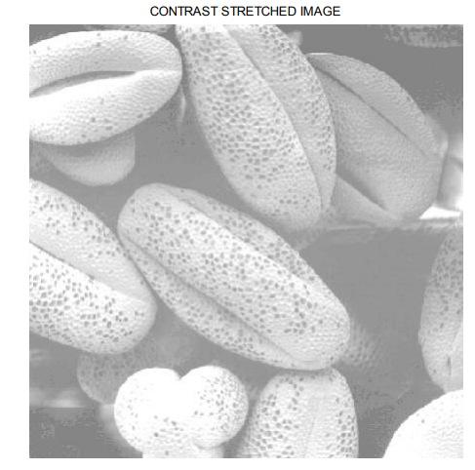
Piece Wise Linear Transformation Function
Contrast stretching (Example)

Slide 17
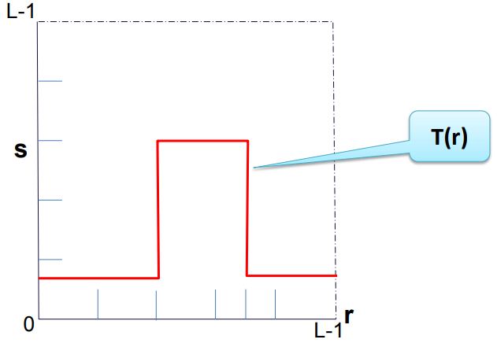
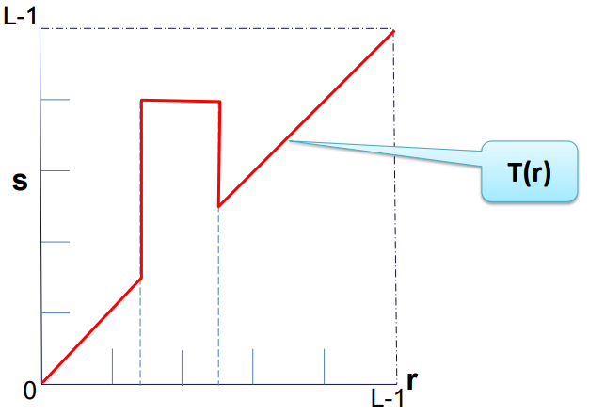
Piece Wise Linear Transformation Function
Intensity Level Slicing
Highlighting specific range of intensities
Example : Enhancing features such as masses of water in the satellite imagery.
Enhancing flaws in X-ray images.
It can be Implemented two ways:
To display only one value (say, white) in the range of interest and rests are black which produces binary image.
Brightens (or darkens) the desired range of intensities but leaves all other intensity levels in the image unchanged.

Slide 18
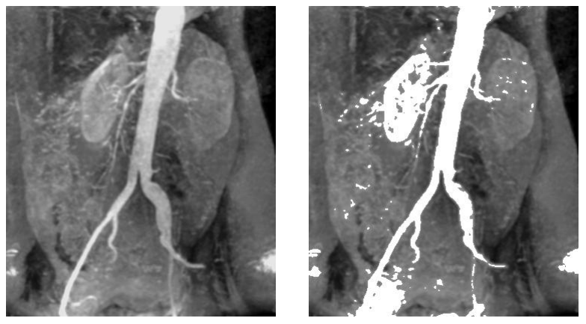
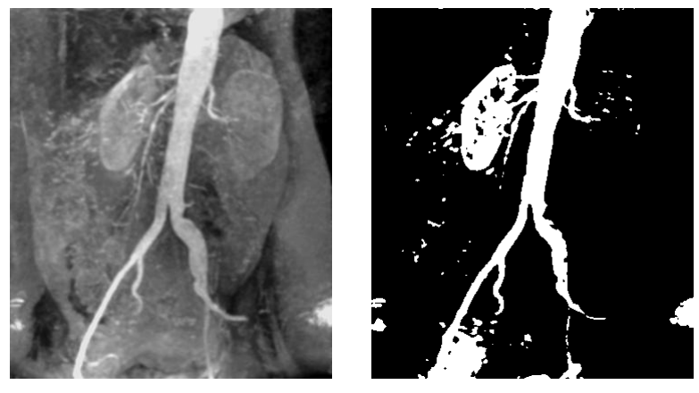
Piece Wise Linear Transformation Function
Intensity Level Slicing example

Slide 19
Piece Wise Linear Transformation Function
clear all;
clc;
itemp = imread('intensity_level_slicing.jpg');%read the image
image = itemp(:,:,1);
rmin = 100; %decide the min. level of intensity level slicing range
rmax = 180; %decide the max. level of intensity level slicing range
[r,c]= size(image); % get the dimensions of image
s = zeros(r,c); % pre allocate a variable to store the result image
Intensity Level Slicing example
for i = 1:r
for j = 1:c
% if the current pixel of original image is in the specfied range then make it 0 in the result image
if (rmin < image(i,j)&& image(i,j) < rmax)
s(i,j) = 0;
else
% otherwise store the same value of the pixel in the result image
s(i,j) = image(i,j);
end
end
end
figure,imshow(uint8(image)) %display original image
figure,imshow(uint8(s)) %display result image

Slide 20
Piece Wise Linear Transformation Function
Intensity Level Slicing example
for i = 1:r
for j = 1:c
% if the current pixel of original image is in the specfied range then make it 0 in the result image
if (rmin < image(i,j)&& image(i,j) < rmax)
s(i,j) = 0;
else
% otherwise store the same value of the pixel in the result image
s(i,j) = image(i,j);
end
end
end
figure,imshow(uint8(image)) %display original image
figure,imshow(uint8(s)) %display result image

Slide 21
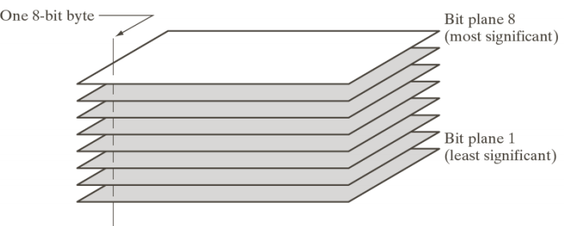
Piece Wise Linear Transformation Function
Bit Plane Slicing
Pixels are digital numbers composed of bits
This transformation is useful In determining the number of Visually significant bits in an Image
Suppose each pixel is represented by 8 bits it is desired To extract the nth most significant bit And display it
Higher-order bits contain the majority of the visually significant data
256 grey scale image is composed of 8 bits. Instead of highlighting intensity level ranges, we could highlight the contribution made to total image appearance by specific bits.
8-bit image may be considered as being composed of eight 1-bit planes, with plane 1 containing the lowest order bit of all pixels in the image and plane 8 all the highest-order bits.
Fig: Bit-Plane representation of a 8 bit number

Slide 22
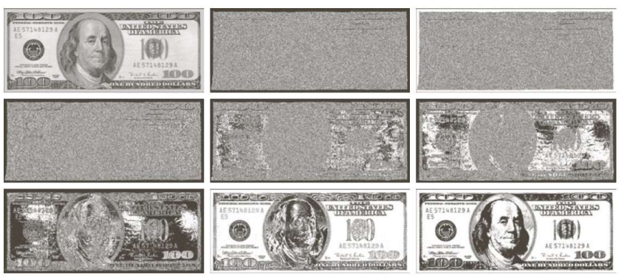
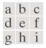
Piece Wise Linear Transformation Function
Bit Plane Slicing example
Fig: (a) An 8-bit gray-scale image of size 500×1192 pixels. (b) through (i) Bit planes 1 through 8, with bit plane 1 corresponding to the least significant bit. Each bit plane is a binary image.

Slide 23
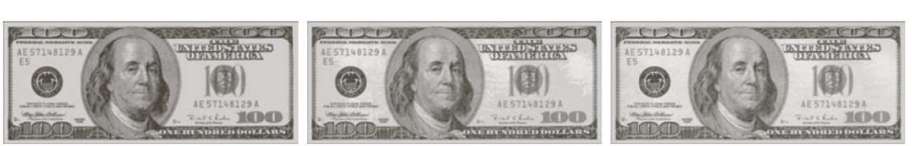
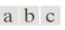
Piece Wise Linear Transformation Function
Bit Plane Slicing example
Fig: Images reconstructed using (a) bit planes 8 and 7; (b)bit planes 8,7 and 6; (c)bit planes 8,7,6 and 5

Slide 24
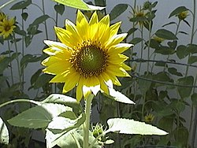
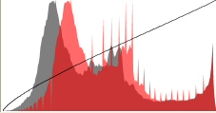
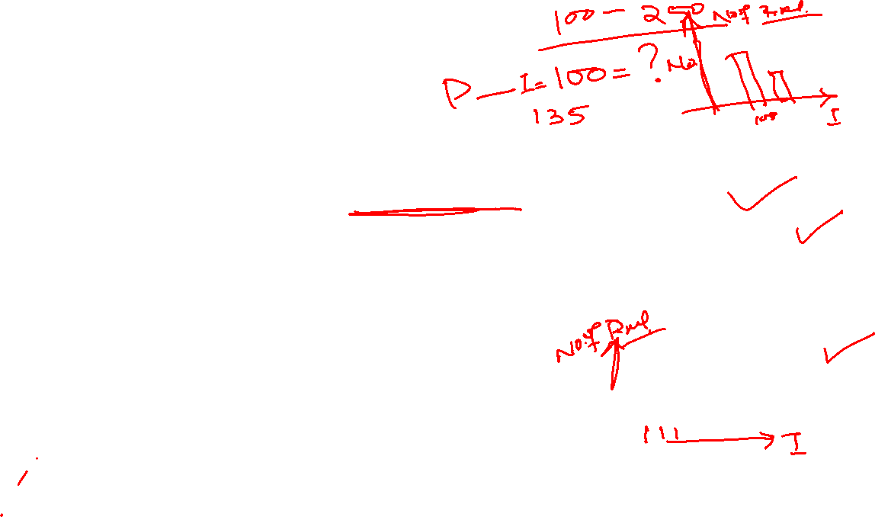
Histogram
An image histogram is a type of histogram that acts as a graphical representation of the tonal distribution in a digital image. It plots the number of pixels for each tonal value. The vertical axis represents the size of the area (total number of pixels) that is captured in each one of these zones.
In simple terms, it represents the number of pixels for each intensity value considered.
What is a histogram and what is its purpose?
The purpose of a histogram (Chambers) is to graphically summarize the distribution of a univariate data set.

Slide 25
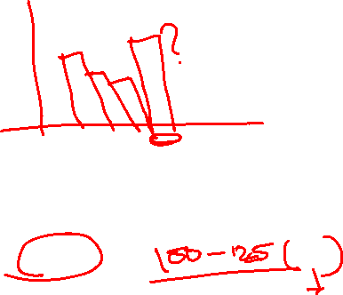
Histogram
A histogram is used to summarize discrete or continuous data. In other words, it provides a visual interpretation of numerical data by showing the number of data points that fall within a specified range of values (called “bins”).
Where are histograms used in real life?
The histograms are mainly used to display and organize a large set of measurements or numerical data in a user-friendly manner. A histogram will make it easy to see where the majority of values fall on a measurement scale, and how much variation is there among those values.
What are the different types of histograms?
The different types of a histogram are uniform histogram, symmetric histogram, bimodal histogram, probability histogram.

Slide 26
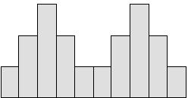
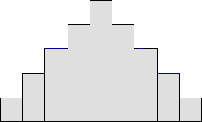
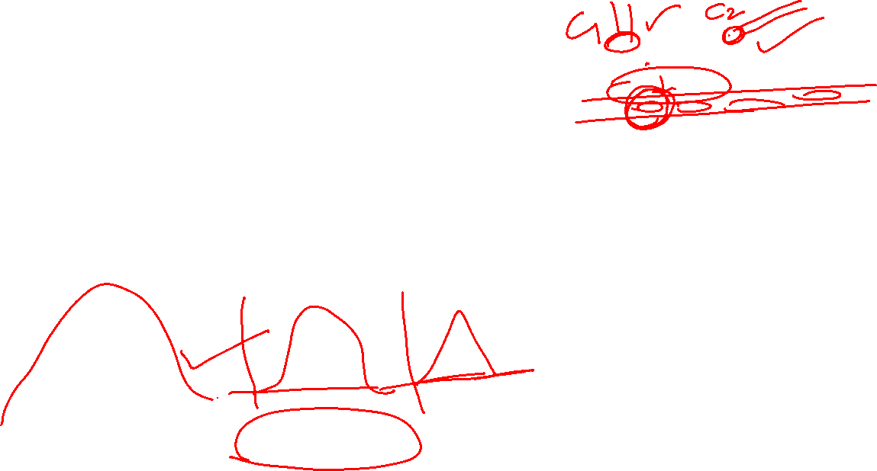
Histogram
What is the importance of image histogram?
Image histograms are an important tool for inspecting images. They allow you to spot BackGround and grey value range at a glance. Also clipping and Quantization Noise in image values can be spotted immediately.
Types:
Bimodal: A bimodal shape has two peaks. This shape may show that the data has come from two different systems. If this shape occurs, the two sources should be separated and analyzed separately.
Bell-shaped: usually presents a normal distribution.

Slide 27
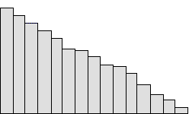
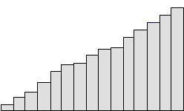
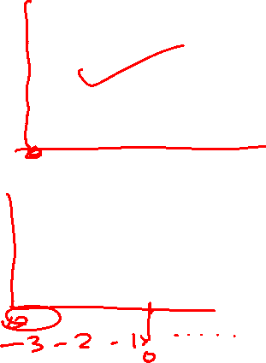
Histogram
Skewed right: Some histograms will show a skewed distribution to the right, as shown in fig. A distribution skewed to the right is said to be positively skewed. This kind of distribution has a large number of occurrences in the lower value cells (left side) and few in the upper value cells (right side). A skewed distribution can result when data is gathered from a system with has a boundary such as zero. In other words, all the collected data has values greater than zero.
Skewed left: Some histograms will show a skewed distribution to the left, as shown in fig. A distribution skewed to the left is said to be negatively skewed. This kind of distribution has a large number of occurrences in the upper value cells (right side) and few in the lower value cells (left side). A skewed distribution can result when data is gathered from a system with a boundary such as 100. In other words, all the collected data has values less than 100.

Slide 28
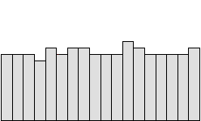
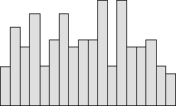

Histogram
Uniform: A uniform distribution, as shown below, provides little information about the system. An example would be a state lottery, in which each class has about the same number of elements. It may describe a distribution which has several modes (peaks). If your histogram has this shape, check to see if several sources of variation have been combined. If so, analyze them separately. If multiple sources of variation do not seem to be the cause of this pattern, different groupings can be tried to see if a more useful pattern results. This could be as simple as changing the starting and ending points of the cells, or changing the number of cells. A uniform distribution often means that the number of classes is too small.
Random: A random distribution, as shown below, has no apparent pattern. Like the uniform distribution, it may describe a distribution that has several modes (peaks). If your histogram has this shape, check to see if several sources of variation have been combined. If so, analyze them separately. If multiple sources of variation do not seem to be the cause of this pattern, different groupings can be tried to see if a more useful pattern results. This could be as simple as changing the starting and ending points of the cells, or changing the number of cells. A random distribution often means there are too many classes.

Slide 29
Histogram
Why histogram equalization is used in image processing?
Histogram equalization is a method to process images in order to adjust the contrast of an image by modifying the intensity distribution of the histogram. The objective of this technique is to give a linear trend to the cumulative probability function associated to the image.

Slide 30
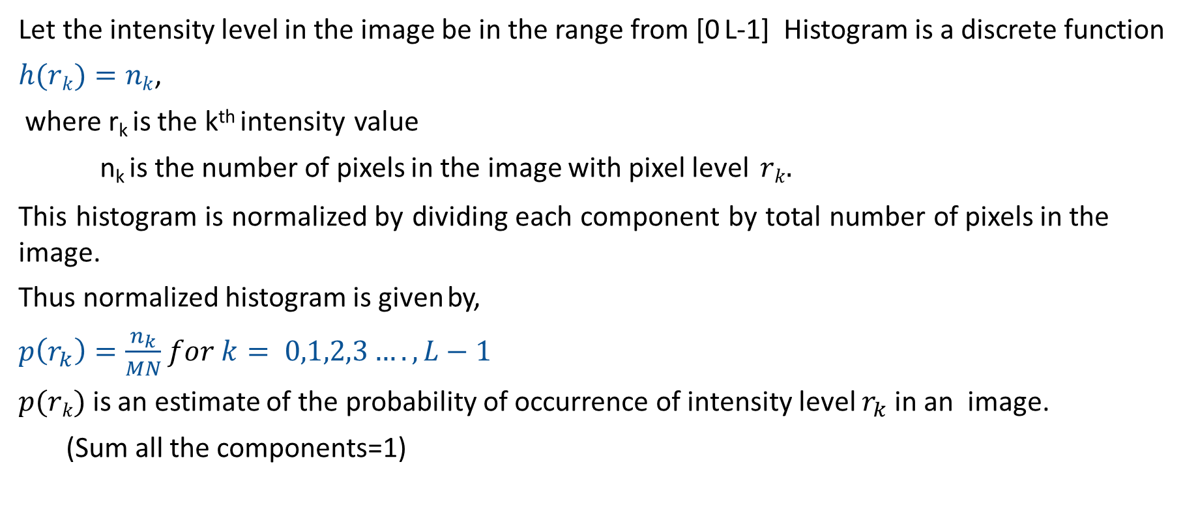
Histogram Processing
Let the intensity level in the image be in the range from [0 L-1] Histogram is a discrete function
$h(rk)=nk$,
where r_{k} is the k^{th} intensity value
n_{k} is the number of pixels in the image with pixel level $rk.$
This histogram is normalized by dividing each component by total number of pixels in the image.
Thus normalized histogram is given by,
$p\left(r_{k}\right)=\frac{n_{k}}{MN}$ $for k= 0,1,2,3….,L−1$
$p(rk)$is an estimate of the probability of occurrence of intensity level $r_{k}$ in an image.
(Sum all the components=1)

Slide 31
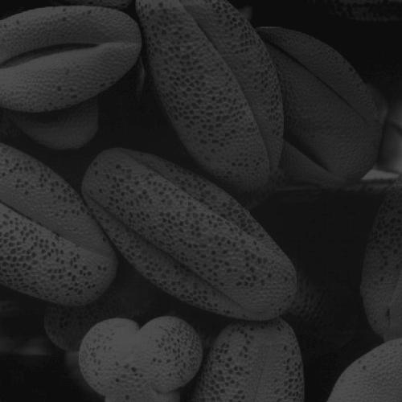
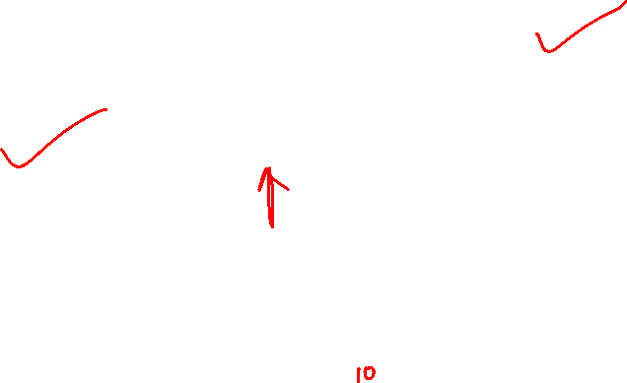
Histogram Processing
6000
5000
4000
3000
2000
1000
0
0
50
100
150
200
250

Slide 32
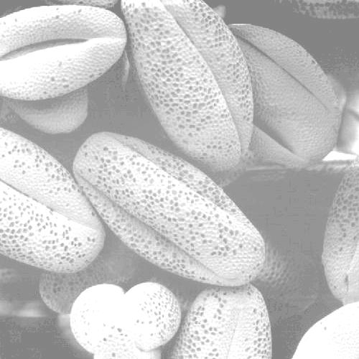

Histogram Processing
7000
6000
5000
4000
3000
2000
1000
0
0
50
100
150
200
250

Slide 33


Histogram Processing
7000
6000
5000
4000
3000
2000
1000
0
0
50
100
150
200
250

Slide 34
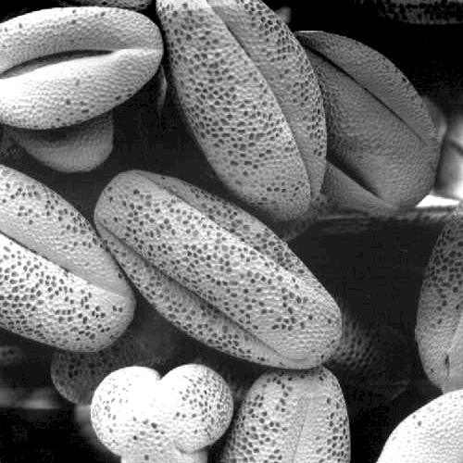
Histogram Processing
4000
3500
3000
2500
2000
1500
1000
500
0
0
50
100
150
200
250

Slide 35
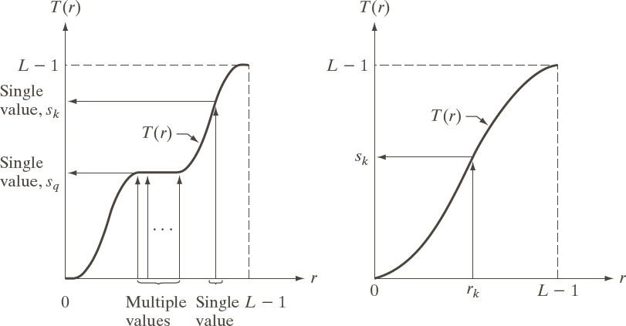

Histogram Equalization
Let us denote r [0 L-1] as intensities of the image to be processed
r=0 corresponding to black and r=L-1 representing white.
Let the intensity transformation is defined by s=T(r) , where0 ≤ r ≤ L-1
T(r) is monotonically increasing function in the interval 0 ≤ r ≤ L-1
0 ≤ T(r) ≤ L-1 and 0 ≤ r ≤ L-1
Suppose we use the inverse operation as r=T⁻¹(s) , then the condition should be strictly monotonically increasing.
Satisfies the condition T(r) is monotonically increasing function in the interval 0 ≤ r ≤ L-1 and
0 ≤ T(r)≤ L-1 and 0 ≤ r≤ L-1
Strictly monotonically increasing
Mapping is one to one in both the directions.

Slide 36







Histogram Equalization
Let us consider intensity levels in the image as random variables in the interval 0 to L-1.
Let us defined the Probability Density Function (PDF) as p_{r}(r) and p_{s}(s) for r and s respectively.
If p_{r}(r) and T(r) is known, where T(r) is continuous and differentiable over the PDF range , then
p (s) p (r) ^{dr}
s r
ds
Cumulative Distribution Function (CDF) of random variable r
The transformation function is of the form
r
s T (r) (L 1) p_{r} (w)dw
0

Slide 37











Histogram Equalization
The transformation function of this form satisfies both the conditions
Now let us compute p_{s}(s), we know s=T(r)
Substituting this for p_{s}(s), we get
ds dT (r)
dr dr
dr
p_{s} (s) p_{r} (r) _{ds}
r
d
p_{r} (w)dw
(L 1)
dr
1
p_{r} (r)
0
(L-1) p_{r} (r)
(L 1) p_{r} (r)
1
L-1
0 s L - 1

Slide 38


Histogram Equalization
Which is a uniform probability density function, this means , performing intensity transformation yields a random variable s characterized by uniform PDF.
It can be noted that T(r) depends on p_{r}(r) but ps(s) is always uniform and independently of the form of p_{r}(r).

Slide 39









Histogram Equalization (Example)
Suppose intensity values in an image have the PDF
2r
p_{r} (r)
for 0 r (L 1)
otherwise
(L 1)²
0
_{r} 2
(L 1)
r
2
r
s T (r) (L 1) p_{r} (w)dw
wdw
(L 1)
0 0
Suppose L=9 and pixel at location say (x,y) has the value r=3, then
s=T(r)= r²/9=1

Slide 40



Histogram Equalization (Example)
The PDF of the intensities in the new image is
$p_{s =}p_{r}$(r)$|\frac{d_{r}}{d_{r}}$| = $\frac{2_{r}}{(L−1)^2}$| ${\text{[}\frac{d_{s}}{d_{r}}\text{]}}^{−1}$|
= $\frac{2_{r}}{(L−1)^2}$| ${\text{[}\frac{d_{r^2}}{d_{r} L−1}\text{]}}^{−1}$|
= $\frac{2_{r}}{(L−1)^2}$ |$\frac{L−1}{2r}$| Assume r is positive and L>1
= $\frac{1}{L−1}$
Result is uniform PDF

Slide 41


Histogram
So what is histogram ? You can consider histogram as a graph or plot, which gives you an overall idea about the intensity distribution of an image. It is a plot with pixel values (ranging from 0 to 255, not always) in X-axis and corresponding number of pixels in the image on Y-axis.
It is just another way of understanding the image. By looking at the histogram of an image, you get intuition about contrast, brightness, intensity distribution etc of that image. Almost all image processing tools today, provides features on histogram.
You can see the image and its histogram. (Remember, this histogram is drawn for grayscale image, not color image). Left region of histogram shows the amount of darker pixels in image and right region shows the amount of brighter pixels. From the histogram, you can see dark region is more than brighter region, and amount of midtones (pixel values in mid-range, say around 127) are very less.

Slide 42




Histogram Equalization
For the discrete values of the histogram , we deal with summation instead of integration
n_{k}
p(r )
k 0,1,2,.......L 1
k
MN
The discrete form of transformation is given by
k
s_{k} T (r_{k} ) (L 1) p_{r} (r_{j} )
j 0
(L 1)
MN
k
n k 0,1,2,........,L-1
j
j 0

Slide 43


Histogram Equalization (Example)
The input pixel r_{k} is mapped to output pixel as s_{k}
The transformation (mapping) T(r_{k}) is called equalization or histogram linearization
Let us consider a 3 bit image (L=8) of 64 x 64 (MN=4096), has the intensity distribution shown below.

Slide 44



Histogram Equalization (Example)
From the equation of histogram equalization , we have
$S_{0}$=T($r_{0}$)$=7\sum_{j_{0}}^{0}{p_{r}}(r_{j})$=$p_{r}(r_{0})$=1.33
$S_{1}$=T($r_{1}$)$=7\sum_{j_{0}}^{1}{p_{r}}(r_{j})$=${7p}_{r}(r_{0})$+${7p}_{r}(r_{1})$
Similarly compute $s_{2},$ $s_{3}….s_{7}$
s₀ | 1.33 | 1
s₁ | 3.08 | 3
s₂ | 4.55 | 5
s₃ | 5.67 | 6
s₄ | 6.23 | 6
s₅ | 6.65 | 7
s₆ | 6.86 | 7
s₇ | 7.00 | 7

Slide 45
Histogram Matching (Specification)
Histogram equalization automatically determines a transformation function produce uniform histogram
When automatic enhancement is desired, equalization is a good approach
There are some applications in which attempting to base enhancement on a uniform histogram is not the best approach
In particular, it is useful sometimes to be able to specify the shape of the histogram that we wish the processed image to have.
The method used to generate a processed image that has a specified histogram is called histogram matching or specification

Slide 46

Histogram Matching (Specification)
Histogram Specification Procedure:
Compute the histogram p_{r} (r) of the given image, and use it to find the histogram equalization transformation in equation
k
n_{j}
∑
, k = 0,1,2,...,L -1
s_{k} = T (r_{k} ) = (L -1)
j=0
MN
and round the resulting values to the integer range [0, L-1]
Compute all values of the transformation function G using same equation G(z_{q} ) = (L -1)$\sum{\text{p}\text{z} \text{(}\text{r}\text{i} \text{),}}$
q =0,1,2,..., L -1 and round values of G
i=0
For every value of s_{k}, k = 0,1,…,L-1, use the stored values of G to find the corresponding value of z_{q} so that G(z_{q}) is closet to s_{k} and store these mappings from s to z.

Slide 47


Histogram Matching (Specification)
Form the histogram-specified image by first histogram- equalizing the input image and then mapping every equalized pixel value, s_{k} , of this image to the corresponding value z_{q} in the histogram-specified image using the mappings found in step 3.

Slide 48

Histogram Matching (Specification)

Slide 49

Histogram Matching (Specification)

Slide 50

Histogram Matching (Specification)

Slide 51


Local Histogram Processing
To enhance details over small areas in an image
Procedure
Define a neighborhood and move its center from pixel to pixel
At each location, the histogram of the points in the neighborhood is computed. Either histogram equalization or histogram specification transformation function is obtained
Map the intensity of the pixel centered in the neighborhood
Move to the next location and repeat the procedure
Fig: (a) original image
(b) Result of global histogram equalization
(c) Result of local histogram equalization applied to (a) using 3×3 neighbourhood

Slide 52

Histogram Statistics for Image Enhancement
Mean gives the average brightness of the image
Variance (σ2) and its square root the standard deviation gives the deviation of intensities on average from the mean value (average contrast)
Let (x,y) denote the coordinates of any pixel in a given image and S_{xy} denote a neighborhood of specified size, centered on (x,y). The mean value of the pixels in this neighborhood is given by the average intensity.
Average Intensity
Variance
Sxy: a neighborhood (sub image)centered at (x,y)

Slide 53

Spatial Filtering
Spatial filtering is an image processing technique for changing the intensities of a pixel according to the intensities of the neighboring pixels.
Also called spatial masks, kernels, templates, and windows.
It consists of
a neighbourhood (typically a small window), and
a predefined operation that is performed on the image pixels encompassed by the neighbourhood.
Filtering creates a new pixel with coordinates equal to the centre of the neighbourhood.
If operation is linear, then filter is called a linear spatial filter otherwise nonlinear.
a=(m-1)/2 and b=(n-1)/2,
m x n (odd numbers)
For x=0,1,…,M-1 and y=0,1,…,N-1

Slide 54


a=(m-1)/2 and b=(n-1)/2,
m x n (odd numbers)
For x=0,1,…,M-1 and y=0,1,…,N-1
Mask coefficients showing coordinate arrangement
The basic approach is to sum products between the mask coefficients and the intensities of the pixels under the mask at a specific location in the image:
(for a 3 x 3 filter)

Slide 55


Smoothing Spatial Filters
Smoothing filters are used for blurring and for noise reduction.
Also called as Averaging filters or Lowpass filter. (It will block high frequency component)
By replacing the value of every pixel in an image by the average of the intensity levels in the neighbourhood defined by the filter mask.
Reduced “sharp” transition in intensities.
Random noise typically consists of sharp transition.
Edges also characterized by sharp intensity
transitions, so averaging filters have the undesirable
side effect that they blur edges.
If all coefficients are equal in filter than it is also called a box filter.
Simple Averaging filter

Slide 56


Smoothing Spatial Filters
The other mask is called weighted average, terminology used to indicate that the pixels are multiplied by different co-efficient.
Centre point is more weighted than any other points.
Strategy behind weighting the centre point the highest and then reducing value of the co-efficient as a function of increasing distance from the origin is simply an attempt to reduce blurring in the smoothing process.
Intensity of smaller object blends with background
Average filter

Slide 57


Smoothing Filter Example
By smoothing the original image we get rid of lots of the finer detail which leaves only the gross features for thresholding
Original Image
Smoothed Image
Thresholded Image

Slide 58


Order Statistics Filter
Response is based on ordering (ranking) the pixels contained in the image area encompassed by the filter, and then replacing the value of the centre pixel with the value determined by the ranking result.
Best-known filter is median filter.
Replaces the value of a centre pixel by the median of the intensity values in the neighbourhood of that pixel.
Used to remove impulse or salt-pepper noise.
Median represents the 50th percentile of a ranked set of numbers while 100th or 0th percentile results in the so- called max filter or min filter respectively.
$\hat{f}$(x,y)=${median}_{(s,t)∈S_{xy}}${g(s,t)}
$\hat{f}$(x,y)=$\max_{(s,t)∈S_{xy}}${g(s,t)}
$\hat{f}$(x,y)=$\min_{(s,t)∈S_{xy}}${g(s,t)}

Slide 59




Example of some Filter
Original image
Averaging filter
Median filter

Slide 60

Sharpening Spatial Filters
Previously we have looked at smoothing filters which remove fine detail
Objective of sharpening filter is high-light fine details in an image or to enhance details that have been blurred.
Sharpening spatial filters seek to highlight fine detail
Remove blurring from images
Highlight edges
Sharpening filters are based on spatial differentiation
image differentiation enhances edges and other discontinuities (such as noise)and
deemphasizes areas with slowly varying intensities.

Slide 61


Sharpening Spatial Filters
Consider a simple 1 dimensional example
A
B

Slide 62

Sharpening Spatial Filters
The first-order derivative of a one-dimensional function f(x) is the difference
The second-order derivative of f(x) as the difference
The 2nd derivative is more useful for image enhancement than the 1st derivative
Stronger response to fine detail
Simpler implementation
We will come back to the 1st order derivative later on

Slide 63
Sharpening Spatial Filters
a first order derivative
must be zero in areas of constant intensity
must be nonzero at the onset of an intensity step or ramp and
must be nonzero along ramps.
For a second order derivatives
must be zero in constant areas
must be nonzero at the onset and
must be zero along ramps of constant slope.

Slide 64

Sharpening Spatial Filters
The first sharpening filter we will discuss is the Laplacian
Isotropic
One of the simplest sharpening filters
We will look at a digital implementation
The Laplacian is defined as follows
where.,
and
∇² f = [ f (x +1, y) + f (x −1, y)+ f (x, y +1) + f (x, y −1)]− 4 f (x, y)

Slide 65

Laplacian Operator
We can easily build a filter based on ∇² f. There are lots of slightly different versions of the Laplacian that can be used:
We can easily build a filter based on ∇² f. There are lots of slightly different versions of the Laplacian that can be used:
0 | 1 | 0
1 | -4 | 1
0 | 1 | 0
-1 | -1 | -1
-1 | 8 | -1
-1 | -1 | -1
∇² f= [ f (x +1, y) + f (x −1,y) + f (x, y +1) + f (x,y−1)+ f (x +1, y+1) + f (x +1,y-1) + f (x+1, y +1) + f (x+1,y−1]− 8 f (x, y
0 | 1 | 0
1 | -4 | 1
0 | 1 | 0
1 | 1 | 1
1 | -8 | 1
1 | 1 | 1
∇² f = [ f (x +1, y) + f (x −1,y) + f (x, y +1) + f (x,−1)]
− 4 f (x, y)

Slide 66

Unsharp Masking and High boost Filtering
Unsharp Masking
High Boost Filtering
Read Original Image f(x,y)
Blurred original image f’(x,y)
Subtract from original image
Mask = f(x,y) – f’(x,y)
add resulting mask to original image
g(x,y) = f(x,y) + Mask
Read Original Image f(x,y)
Blurred original image f’(x,y)
Subtract from original image
Mask = f(x,y) – f’(x,y)
add resulting mask to original image
g(x,y) = f(x,y) + k*Mask, where k>1

Slide 67


Unsharp Masking and High boost Filtering
Fig: 1-D illustration of the mechanics of unsharp masking
(a)Original signal.
(b) blurred signal with original shown dashed for reference.
(c) unsharp mask
(d) sharpened signal obtained by adding c to a

Slide 68




1st Derivative Filtering
Implementing 1st derivative filters is difficult in practice
For a function f(x, y) the gradient of f at coordinates (x, y) is given as the column vector:
For a function f(x, y) the gradient of f at coordinates (x, y) is given as the column vector:

Slide 69

Sobel Operators
There is some debate as to how best to calculate these gradients which is based on these coordinates
Based on these we can derive the Sobel Operators
∇f ≈ (z₇ + 2z₈ + z₉ )− (z₁ + 2z₂ + z₃ )
+ (z₃ + 2z₆ + z₉ )− (z₁ + 2z₄ + z₇ )
To filter an image it is filtered using both operators the results of which are added together
z₁ | z₂ | z₃
z₄ | z₅ | z₆
z₇ | z₈ | z₉
-1 | -2 | -1
0 | 0 | 0
1 | 2 | 1
-1 | -2 | -1
0 | 0 | 0
1 | 2 | 1

Slide 70



Example of Sobel Operators
An image of a contact lens which is enhanced in order to make defects (at four and five o’clock in the image) more obvious

Slide 71
Comparison of 1st & 2nd Derivatives
1st order derivatives generally produce thicker edges
2nd order derivatives have a stronger response to fine detail e.g. thin lines
1st order derivatives have stronger response to grey level step
2nd order derivatives produce a double response at step changes in grey level

Slide 72



Idea Behind Fourier Transform
=
Any function that periodically repeats itself can be expressed as a sum of sines and cosines of different frequencies each multiplied by a different coefficient – a Fourier series

Slide 73
The Discrete Fourier Transform (DFT)
Functions that are not periodic can be expressed as the integral of sines and/or cosines multiplied by a weighting functions
Frequency up to infinity
Functions ←--→ Fourier transform
Operation in frequency domain
without loss of information

Slide 74

1-D Fourier Transform
Fourier transform F(u) of a continuous function f(x) is:
Inverse transform:
Forward Fourier transform:

Slide 75
2-D Fourier Transform
Fourier transform F(u,v) of a continuous function f(x,y) is:
Inverse transform:
x
u
F
y
v

Slide 76
1-D Fourier Transform
1950, fast Fourier transform (FFT)
Revolution in the signal processing
Discrete Fourier transform (DFT)
For digital computation
Fourier transform F(u) of a continuous function f(x) is:
Inverse transform:
Forward Fourier transform:

Slide 77

1-D Discrete Fourier Transform
f(x), x=0,1,…,M-1 . discrete function
F(u), u=0,1,…,M-1. DFT of f(x)
Inverse transform:
Forward discrete Fourier transform:

Slide 78

Frequency Domain
frequency domain
j
Euler’s formula:
1
F(u)
frequency
for x = 0, 1, 2…M-1 and y = 0, 1, 2…N-1
u

Slide 79


Frequency Domain
Fourier
transform

Slide 80
Complex Quantities to Real Quantities
Useful representation
magnitude
phase
Power spectrum

Slide 81
Fourier transform
Fourier transform works globally
No direct relationship between a specific components in an image and frequencies
Intuition about frequency
Frequency content
Rate of change of gray levels in an image

Slide 82


Basics of filtering in the frequency domain
To filter an image in the frequency domain:
Compute F(u,v) the DFT of the image
Multiply F(u,v) by a filter function H(u,v)
Compute the inverse DFT of the result

Slide 83

Smoothing Frequency Domain Filters
Smoothing is achieved in the frequency domain by dropping out the high frequency components
The basic model for filtering is: G(u,v) = H(u,v)F(u,v)
where F(u,v) is the Fourier transform of the image being filtered and
H(u,v) is the filter transform function
Low pass filters – only pass the low frequencies, drop the high ones.

Slide 84


Ideal Low Pass Filter
Simply cut off all high frequency components that are a specified distance $D_{0}$ from the origin of the transform
changing the distance changes the behaviour of the filter

Slide 85


Ideal Low Pass Filter (cont…)
The transfer function for the ideal low pass filter can be given as:
where D(u,v) is given as:

Slide 86


Ideal Low Pass Filter (cont…)
Result of filtering
Original
image
with ideal
low pass
filter of radius 5
Result of filtering
with ideal low pass
filter of radius 15
Result of filtering
with ideal low pass
filter of radius 30
Result of filtering
with ideal low pass
filter of radius 80
Result of filtering
with ideal low pass
filter of radius 230

Slide 87


Ideal Low Pass Filter (cont…)
Result of filtering
with ideal low pass
filter of radius 5
Result of filtering with ideal low pass filter of radius 15

Slide 88



Butterworth Lowpass Filters
The transfer function of a Butterworth lowpass filter of order n with cutoff frequency at distance d0 from the origin is defined as:

Slide 89

Butterworth Lowpass Filter (cont…)
Result of filtering
with Butterworth filter
Original
image
of order 2 and cutoff
radius 5
Result of filtering with
Butterworth filter of
order 2 and cutoff radius 15
Result of filtering
with Butterworth
filter of order 2 and
cutoff radius 30
Result of filtering with
Butterworth filter of
order 2 and cutoff
radius 80
Result of filtering
with Butterworth
filter of order 2 and
cutoff radius 230

Slide 90

Rough Page

Slide 91
Rough Page

Slide 92


Butterworth Lowpass Filter (cont…)
Original
image
Result of filtering
with Butterworth filter
of order 2 and cutoff
radius 5
Result of filtering with Butterworth filter of order 2 and cutoff radius 15

Slide 93


Gaussian Lowpass Filters
The transfer function of a Gaussian lowpass filter is defined as:

Slide 94

Gaussian Lowpass Filters (cont…)
Original image
Result of filtering with Gaussian filter with cutoff radius 5
Result of filtering with Gaussian filter with cutoff radius 15
Result of filtering with Gaussian filter with cutoff radius 30
Result of filtering with Gaussian filter with cutoff radius 85
Result of filtering with Gaussian filter with cutoff radius 230

Slide 95



Lowpass Filters Comparision
Result of filtering with
ideal low pass
filter of radius 15
Result of filtering with Gaussian filter with cutoff radius 15
Result of filtering with Butterworth filter of order 2 and cutoff radius 15

Slide 96


Lowpass Filtering Examples

Slide 97

Lowpass Filtering Examples (cont…)
Original
image
Gaussian lowpass
filter
Spectrum of
original image
Processed
image

Slide 98



Sharpening in the Frequency Domain
Edges and fine detail in images are associated with high frequency components
High pass filters
only pass the high frequencies, drop the low ones.
High pass frequencies are precisely the reverse of low pass filters
H
(u, v) = 1 – H (u, v)
hp
lp
Ideal High Pass Filters
The ideal high pass filter is given as:
where D₀ is the cut off distance as before

Slide 99



Ideal High Pass Filters example
Results of ideal high pass filtering with D₀ = 15
Results of idealhigh
pass filteringwith D₀ = 30
Results of ideal high pass filtering with D₀ = 80

Slide 100


Butterworth High Pass Filters
The Butterworth high pass filter is given as:
where n is the order and D₀ is the cut off distance as before

Slide 101

Butterworth High Pass Filters (cont…)
Results of Butterworth high pass filtering of order 2 with D₀= 80
Results of Butterworth high pass filtering of order 2 with D₀ = 15
Results of Butterworth high pass filtering of order 2 with D₀ = 30

Slide 102


Gaussian High Pass Filters
The Gaussian high pass filter is given as:
where D₀ is the cut off distance as before

Slide 103


Gaussian High Pass Filters (cont…)
Results of Gaussian
high pass filtering with
D₀ = 15
Results of
Gaussian high pass
filtering with D₀ = 80
Results of Gaussian high pass
filtering with D₀ = 30

Slide 104



Highpass Filter Comparison
Results of ideal
high pass filtering
with D₀ = 15
Results of Butterworth
high pass filtering of order2 with D₀ = 15
Results of Gaussian
high pass filtering with D₀ = 15

Slide 105

Highpass Filtering Example
Original image
Highpass filtering result
High frequency
emphasis result
After histogram
equalisation

